Slide 1
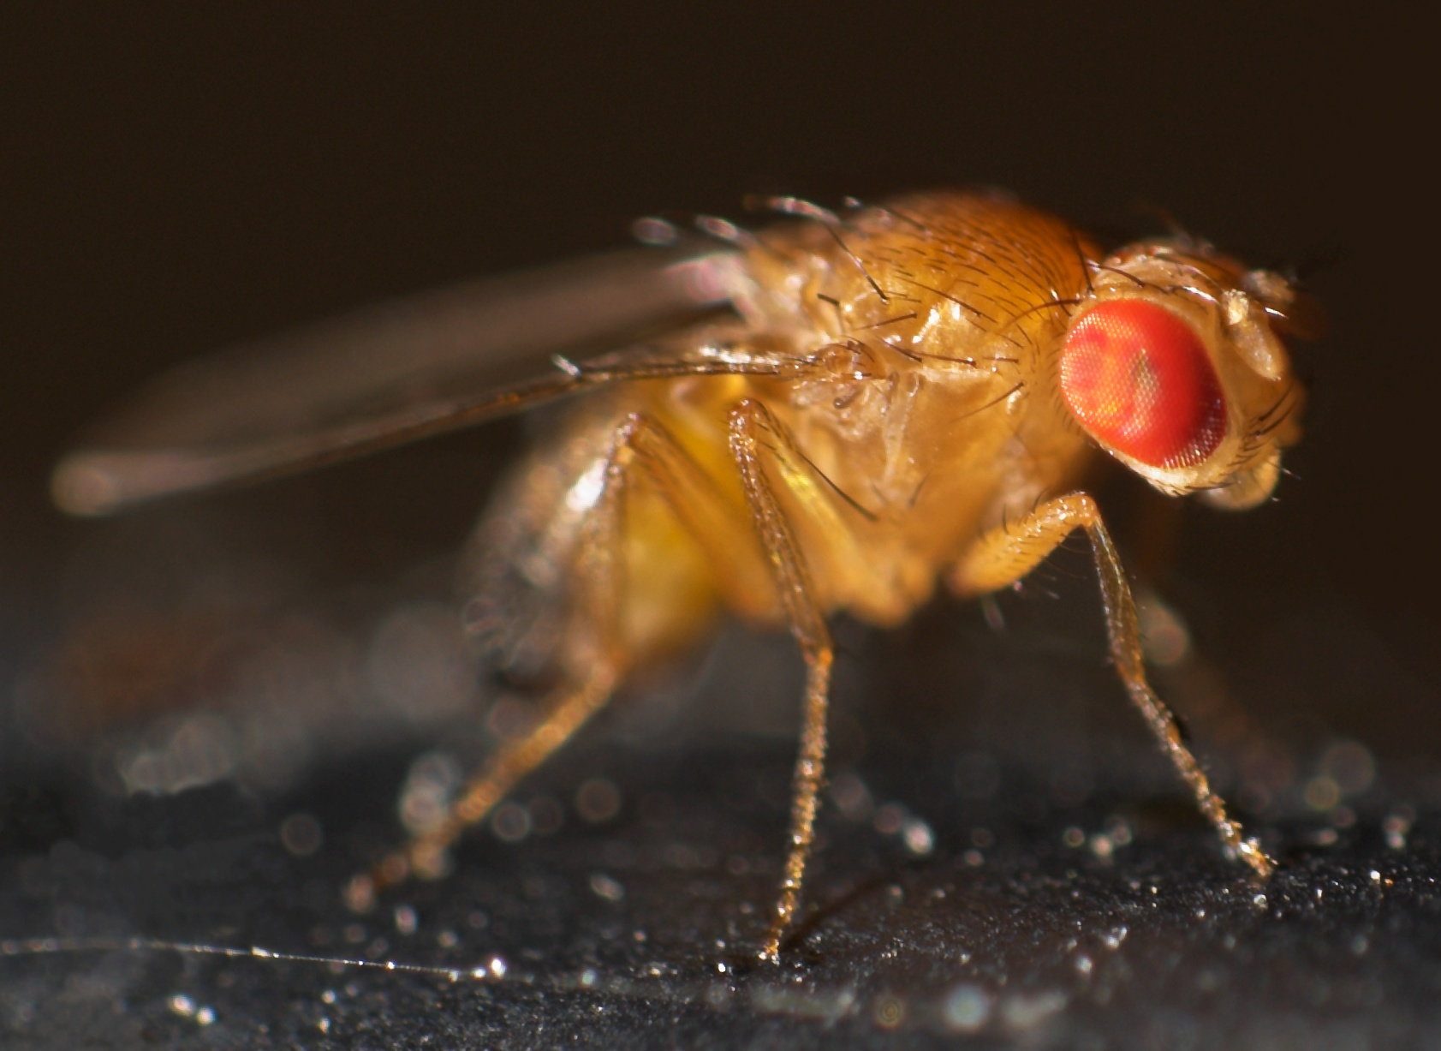
Candidate lncRNA Detection
Hannah Khan and Jiun Tseng

Slide 2
Project Overview
Comparing the differential expression of lncRNAs from 3 data sets
Notes:
The goal of our project is to compare transcriptomic differences between flies exposed to three temperature shock conditions which were heat shock, cold shock and the control. We used three data sets, which were two publically available sets of data and one experimental group is the developmental acclimation from most recent sequencing run (cahan). For the purpose of this talk, we will focus on the publically available data from modENCODE. We are specifically interested in identifying differentially expressed lncRNAs in these groups with the goal of identifying candidate lncRNAs to use for qPCR validation next week. We are doing this validation to make sure that the samples that we are working with are exhibiting the temperature dependent responses that we expect to see before continuing with the sequencing process.
Remove the sentence add a flow chart with the process

Slide 3
Long Non-coding RNA Overview (lncRNA)
>200 nucleotides
Over 17,000 lncRNAs have been identified to date
Transcribed by RNA polymerase II, polyA tails, regulated by transcription factors and multiexonic with multiple isoforms
Differentially expressed during development, indicating that they may influence cell fate
Associated with numerous diseases
Have diverse regulatory roles that influence gene expression
Notes:
Long non-coding RNAs are transcripts with lengths greater than 200 nucleotides. Originally, lncRNAs were thought to be junk, however, it has recently been discovered that they are very influential. Over 17,000 lncRNAs have been identified to date. lncRNAs are transcribed by RNA polymerase II, and are regulated by transcription factors and are multiexonic with multiple isoforms. They are found to be differentially expressed during development, which indicates that they may influence cell fate. lncRNAs are associated with numerous diseases. lncRNAs have diverse regulatory roles that influence gene expression.

Slide 4
Joe’s RNA-seq Processing Pipeline
Why we use a pipeline
Reduces repeated work
Creates a uniform output and correct solution
A faster way to get the same information
What a pipeline is
Scripts that connect multiple data processing/analysis steps together
Yields reproducible results and easy to use inputs
Notes:
Switch what is a pipeline with why

Slide 5
General RNA-seq Workflow
Biological samples/Library preparation
Sequence read (FASTQ)
FASTQC
Adapter Trimming (Optional)
Joe’s Pipeline
Splice-aware mapping to genome
Counting reads associated with genes
Statistical analysis to identify differentially expressed genes
Notes:
First, we start with the biological samples that are flies that has been treated with different conditions. These samples are undergoing library preparations (using tecan kit, wholeRNA, start with fragmentation of the RNA, convert it to cDNA, rRNA depletion, add in adapters, do PCR to be quantified), upon receiving sequenced reads, they are in the form of FASTQ files, which then we trim the unique adaptors to get the fragment of interest to be amplified.
FASTQ : large files, has all the sequencing reads from the sequence library, take 4 as reads, another line is a QC factor, converted to a sam file, converted to bm file, counts
FASTQ will be put through FASTQC to ensure the quality

Slide 6
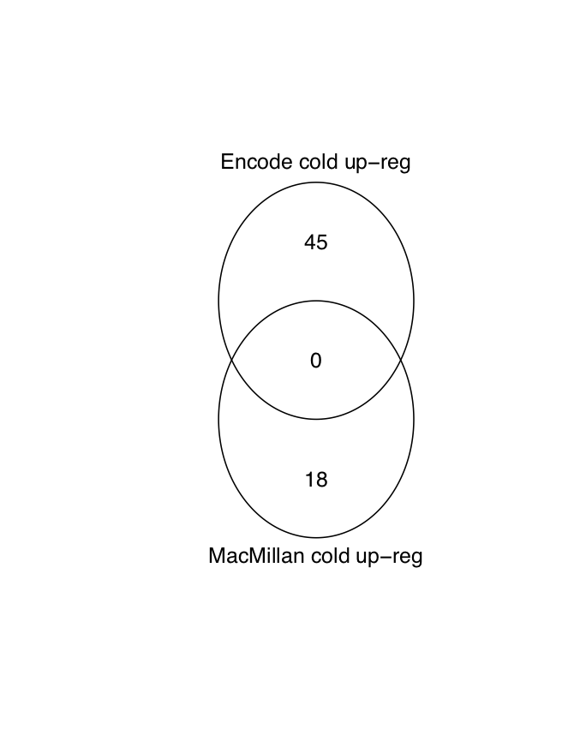
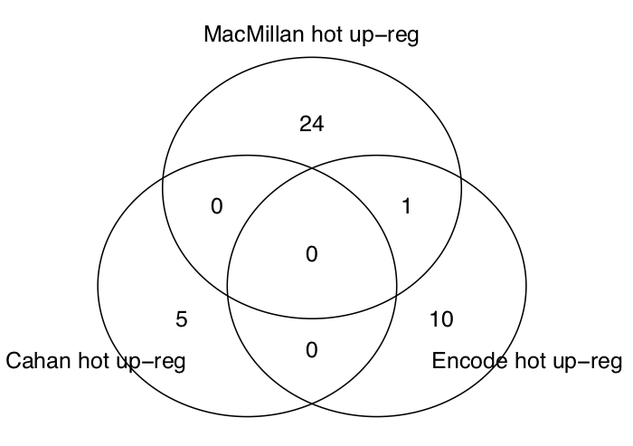
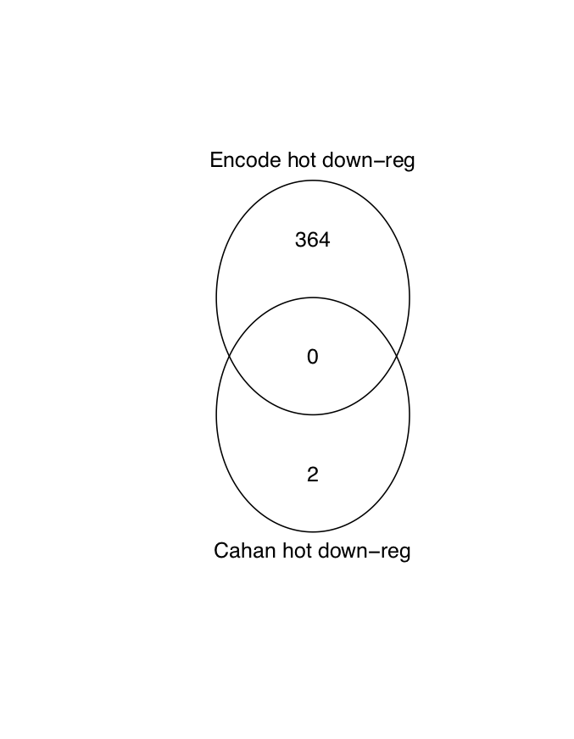
Differentially Expressed lncRNAs Comparing Three Data Sets
Notes:
Left, center, right

Slide 7
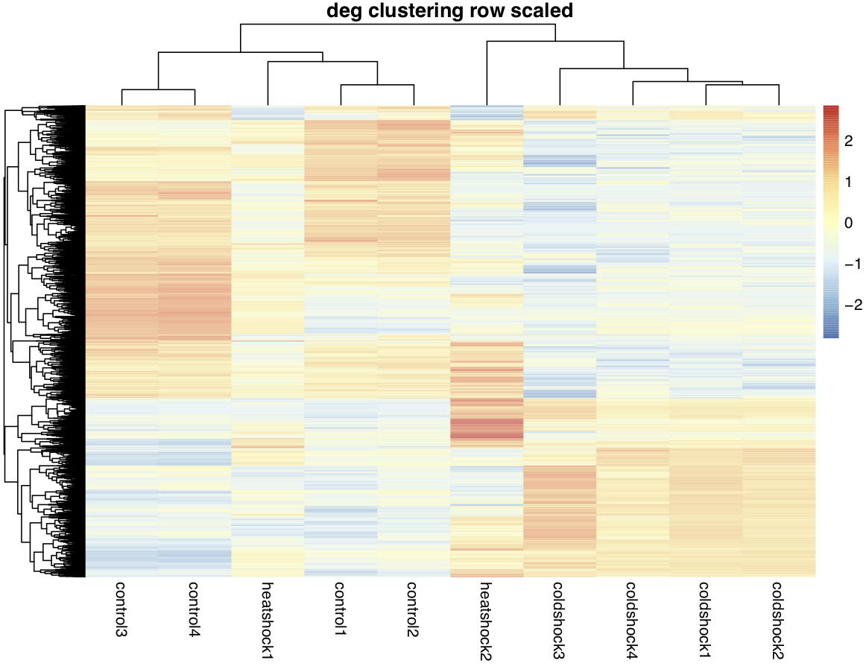
Heat Map
Notes:
Encode data
All differentially expressed genes (mRNA+lncRNA)
Any genes that are different between cold vs control and hot vs control
*library control, hot, cold

Slide 8
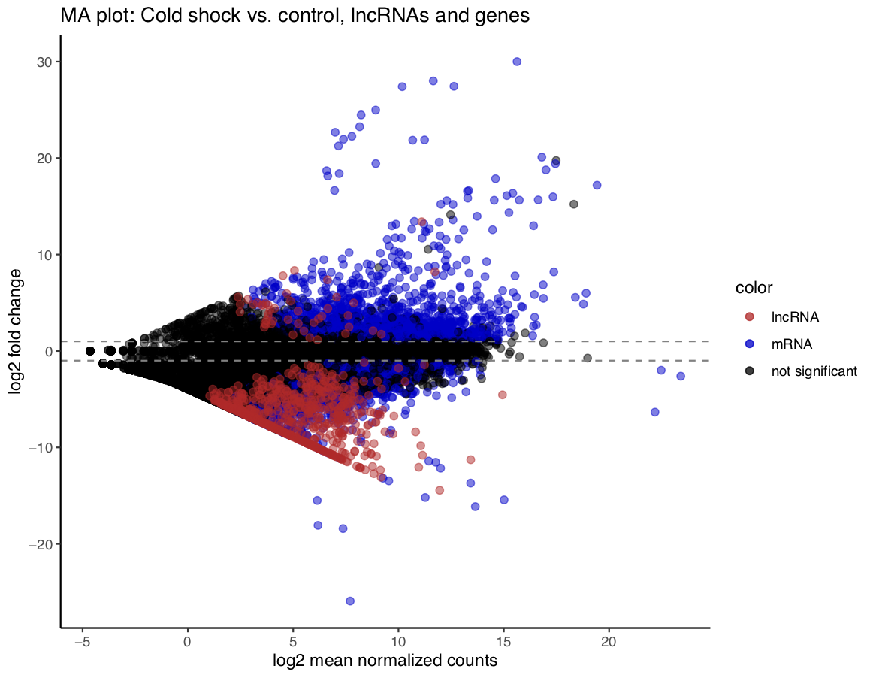
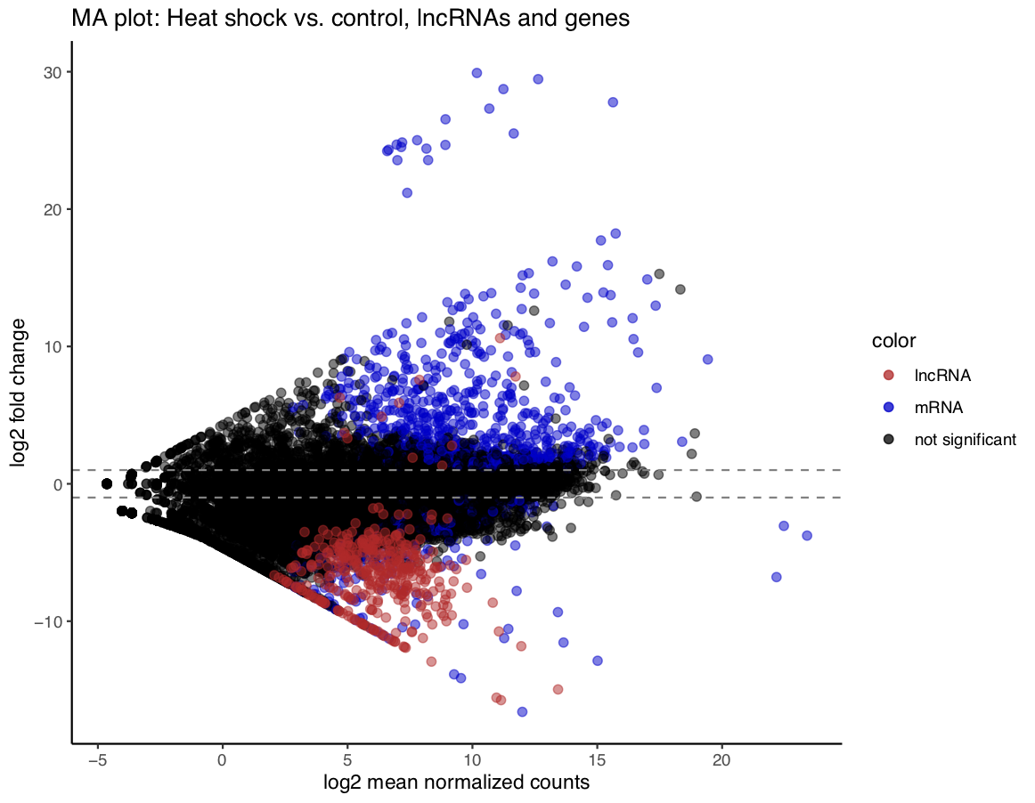
DE lncRNAs and mRNAs in Encode data
Notes:
We want to represent heat map in another way to specify the difference between lncRNA and mRNA the degs in another way, in which we make MA plots, red represent lncRNA and blue represents mRNA on the right we are comparing cold vs control, heat vs control, in what we are seeing, add bar plots, how many lnc RNA and mRNA
Pathway analysis : using we can take a list of deg of hot and cold shock and we input into a pathway analysis tool to fit those genes in a
Biological pathway

Slide 9


Acknowledgements
Sophie Kogut
Princess Rodriguez (PhD)
Joseph Boyd
Dr. Seth Frietze (PhD)
Frietze Lab
Cahan Lab
Lockwood Lab
University of Vermont
NSF Grant – From Genome to Phenome in a Stressful World: Epigenetic Regulatory Mechanisms Mediating Thermal Plasticity in Drosophila
Notes:
Joseph (MS)
To follow up in X and X plathway
Low FDR, we would like to follow up on looking at

